Slide 1

Introduction To Reinforcement Learning​
Thien-Minh Nguyen, PhD
Centre for Advance Robotics Technology Innovation
April 2025

Slide 2
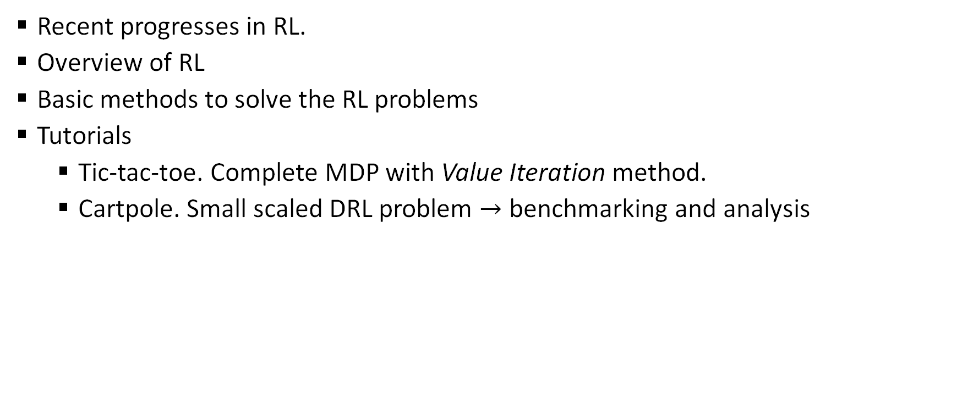
Outline
Recent progresses in RL.
Overview of RL
Basic methods to solve the RL problems
Tutorials
Tic-tac-toe. Complete MDP with Value Iteration method.
Cartpole. Small scaled DRL problem $→$ benchmarking and analysis

Slide 3
Objectives
Exposure to mathematical formulism of RL.
Familiarize with basic concepts of Reinforcement Learning (RL).
In the context of RL…
Agent, environment, observations, state, reward, action, value, return, discount …
Evaluation, Iteration, Improvement, Value Iteration …
Monte Carlo, Off-policy
Temporal Difference, Q-learning, Sarsa
Function Approximation
Policy Gradient Methods

Slide 4
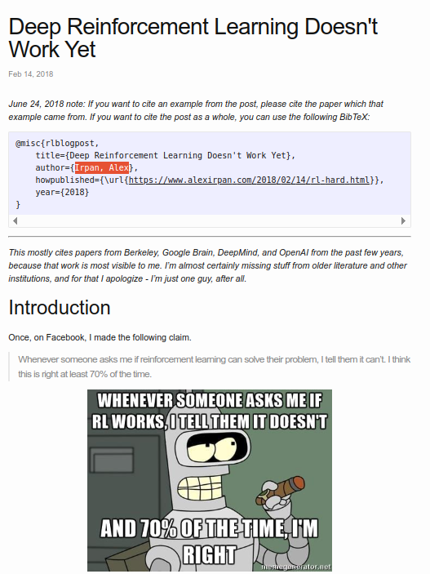
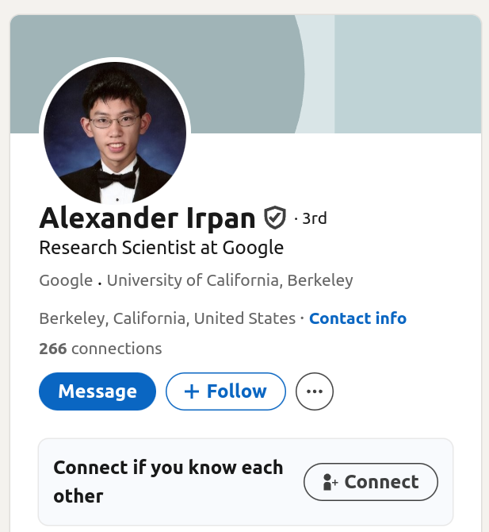
https://www.alexirpan.com/2018/02/14/rl-hard.html

Slide 5
Why RL ain’t work?
Sample Inefficient
Can be solved by other methods
Always requires a reward function
Reward function design is difficult
Local optima hard to escape
Overfitting
Unstable and hard to reproduce

Slide 6
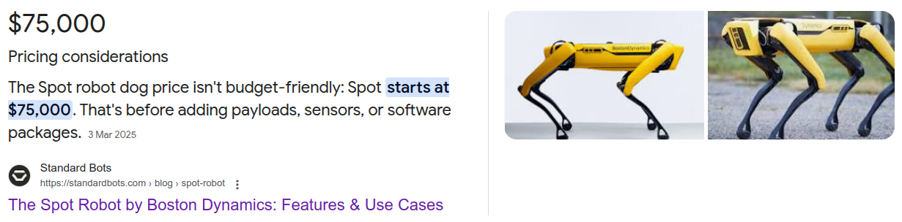

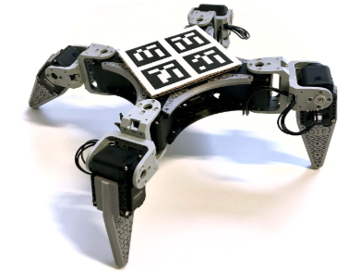
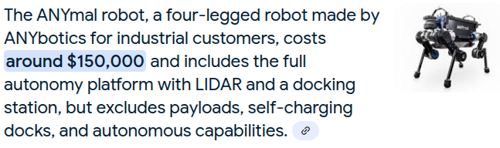

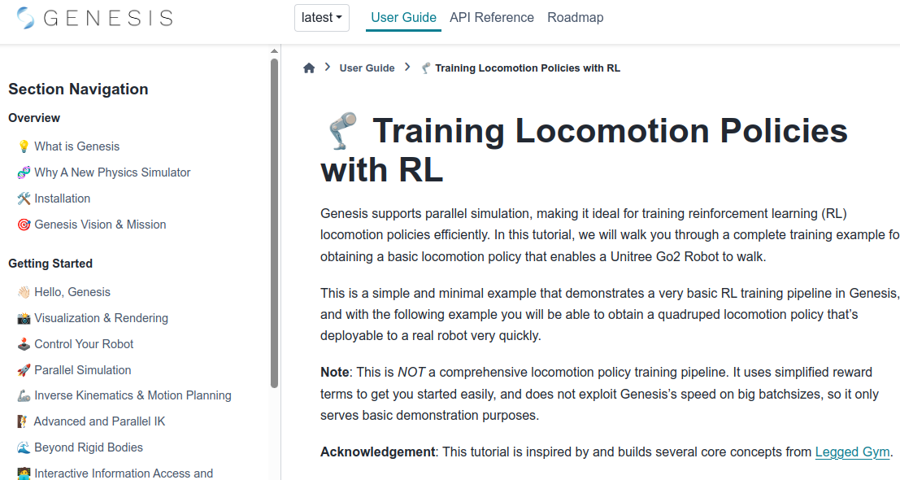
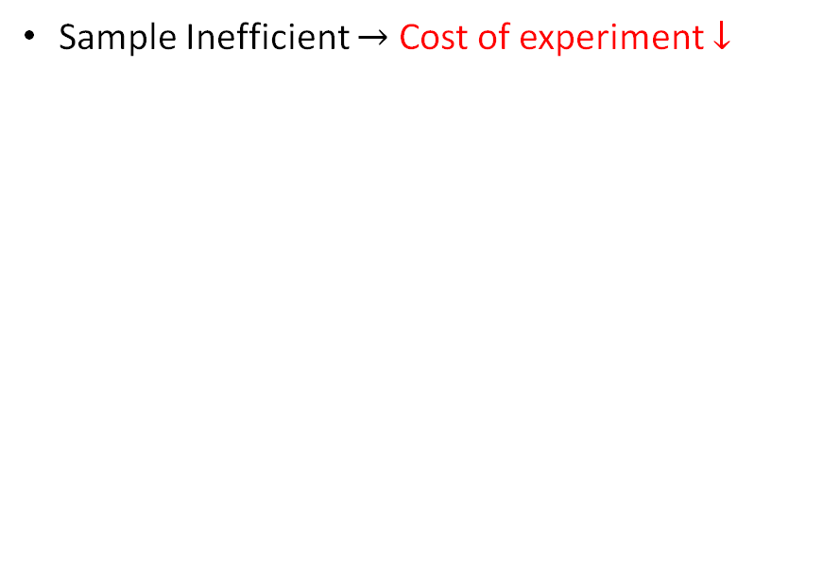
Why RL works now?
Sample Inefficient $→$ Cost of experiment $↓$

Slide 7
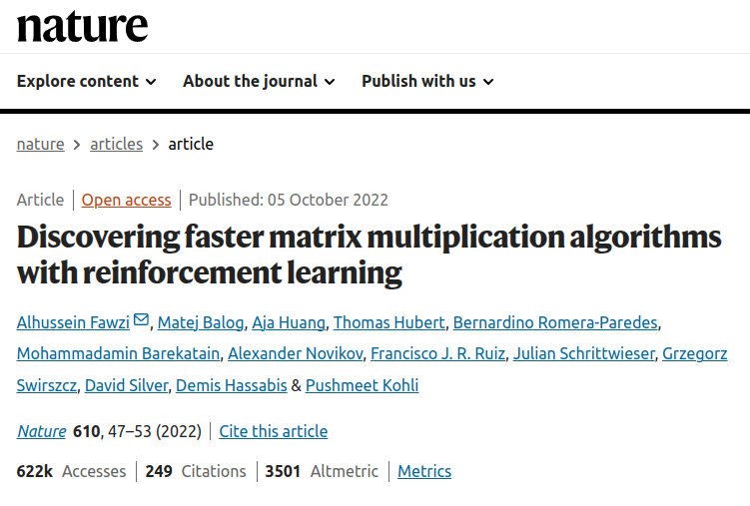
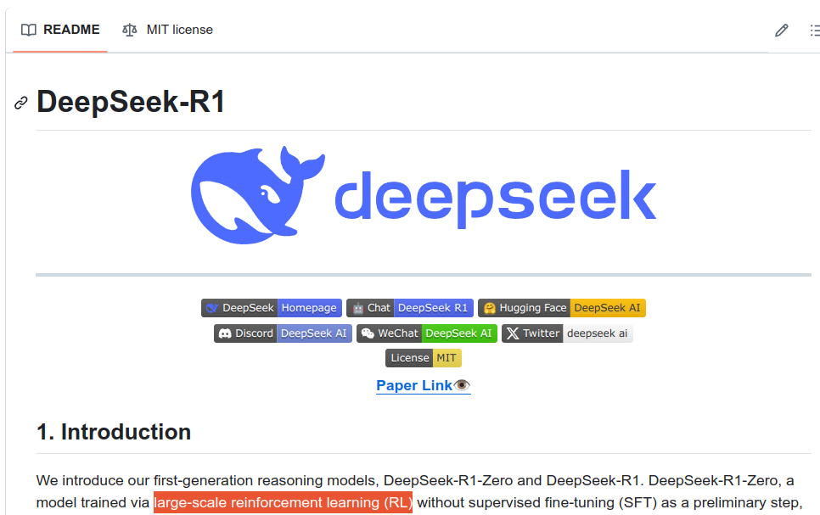
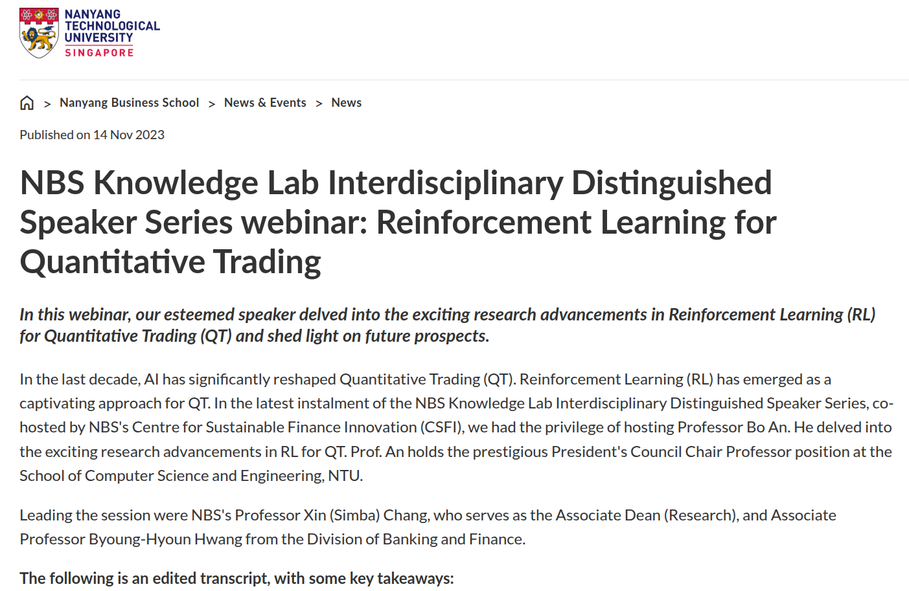
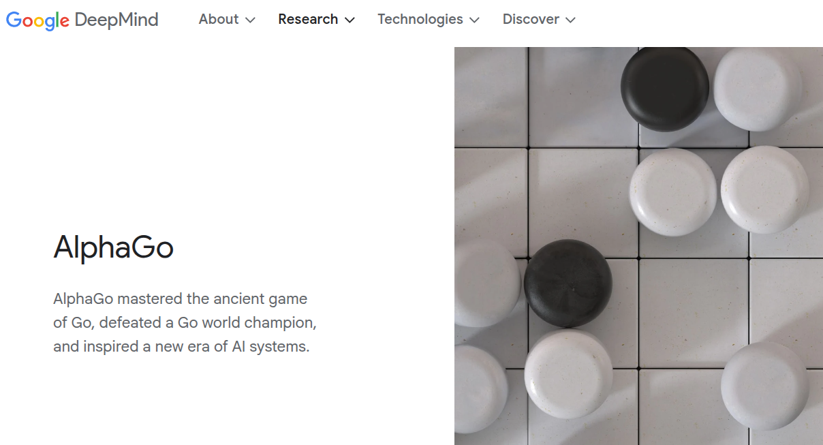
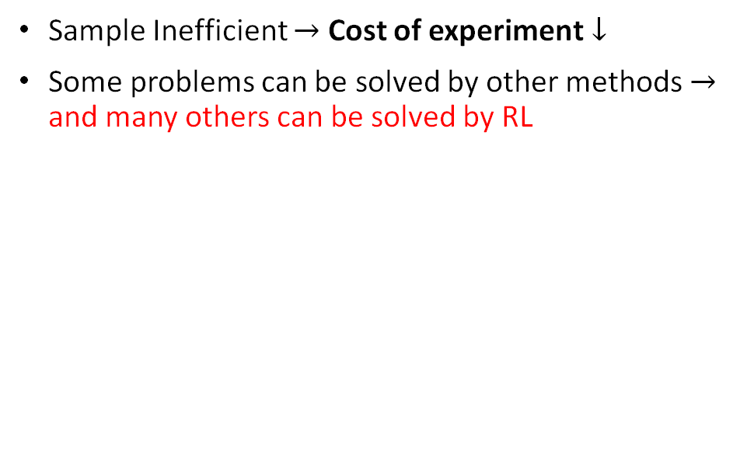
Why RL works now?
Sample Inefficient $→$ Cost of experiment $↓$
Some problems can be solved by other methods $→$ and many others can be solved by RL

Slide 8
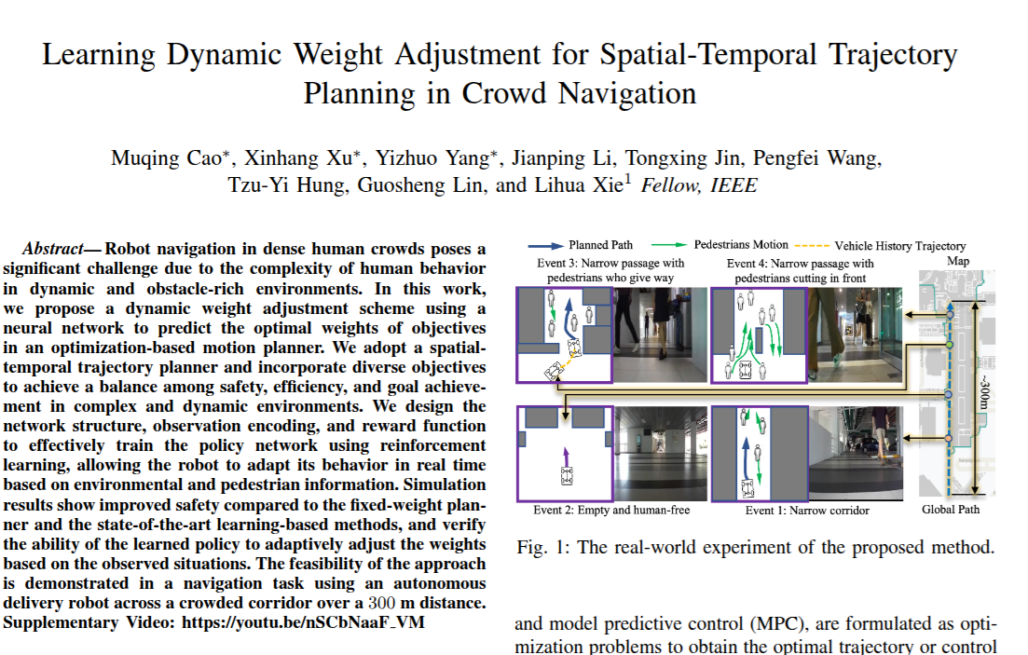
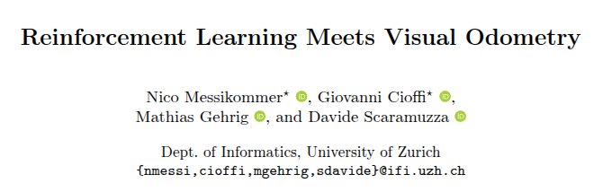
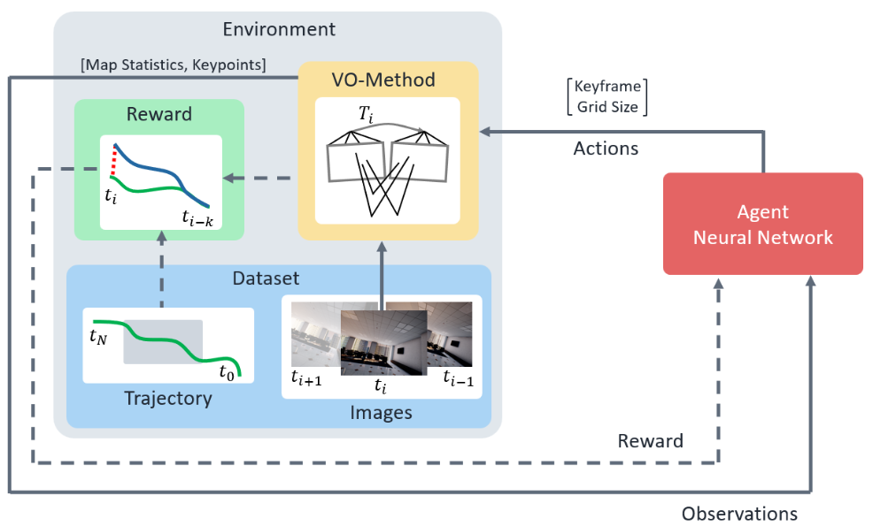
Why RL works now?
Sample Inefficient $→$ Cost of experiment $↓$
Some problems can be solved by other methods $→$ and many others can be solved by RL

Slide 9
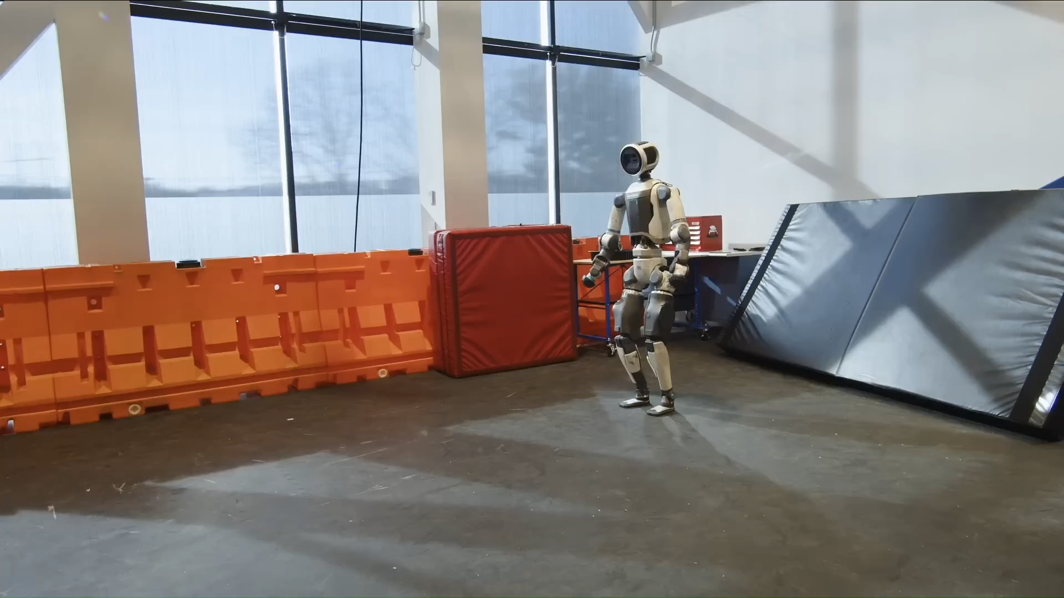
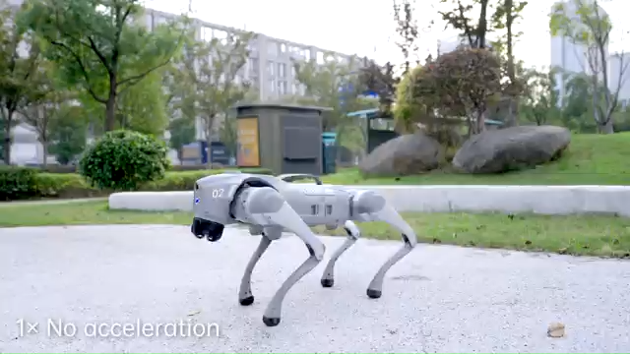
Why RL works now?
Sample Inefficient $→$ Cost of experiment $↓$
Some problems can be solved by other methods $→$ and many others can be solved by RL

Slide 10
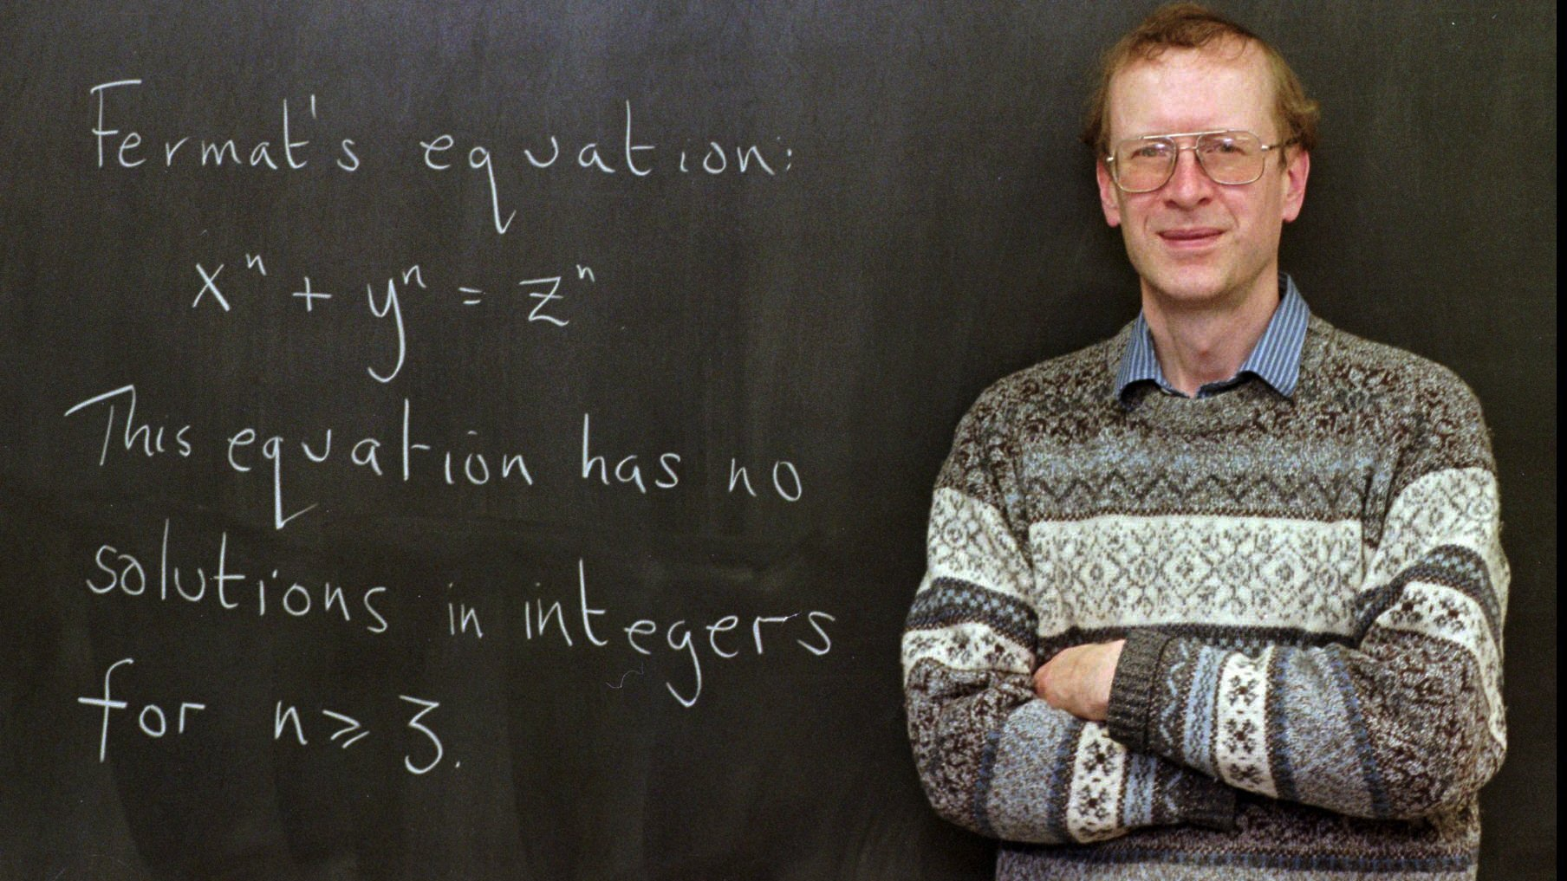
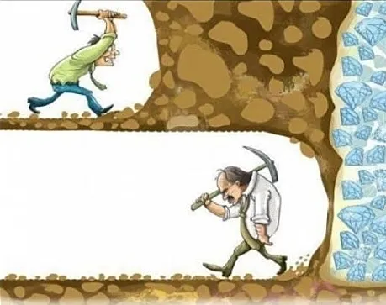
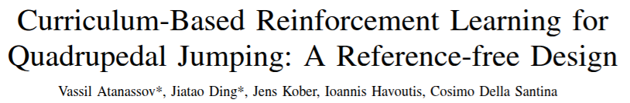
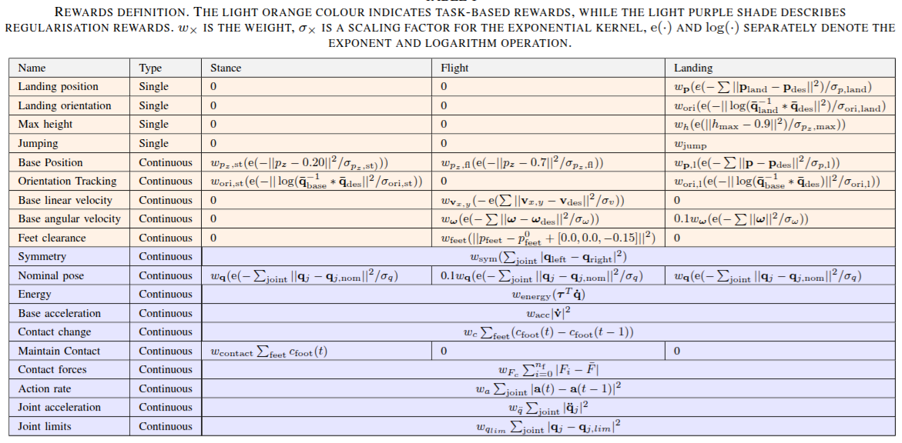
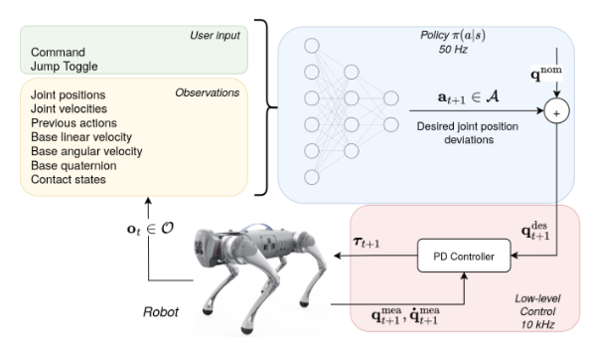
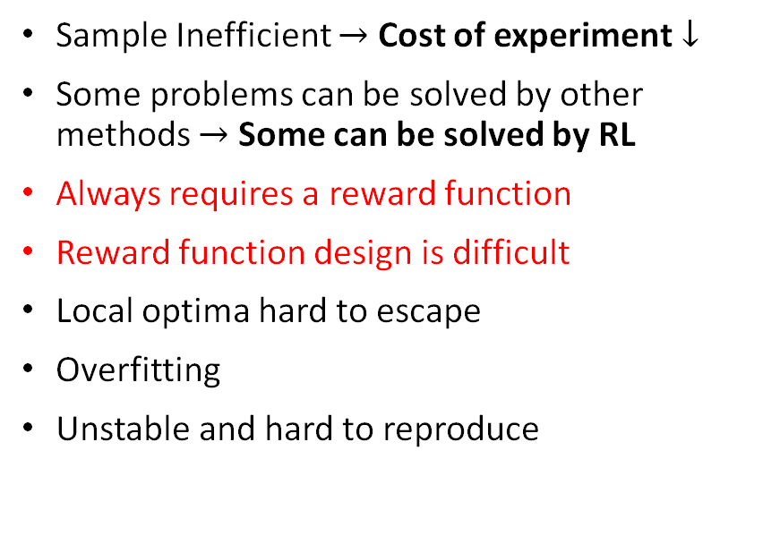
Why RL works now?
Sample Inefficient $→$ Cost of experiment $↓$
Some problems can be solved by other methods $→$ Some can be solved by RL
Always requires a reward function
Reward function design is difficult
Local optima hard to escape
Overfitting
Unstable and hard to reproduce

Slide 11
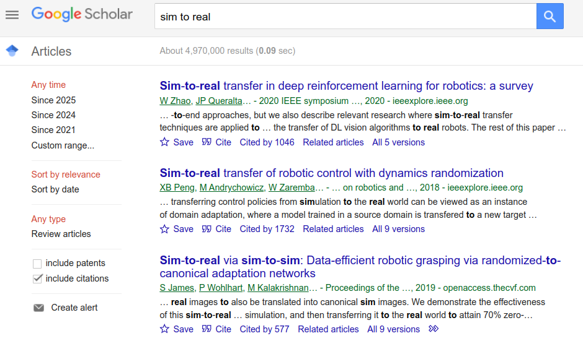
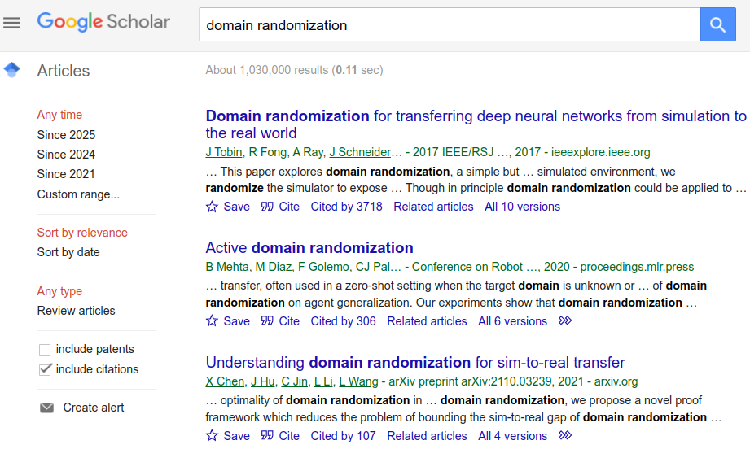
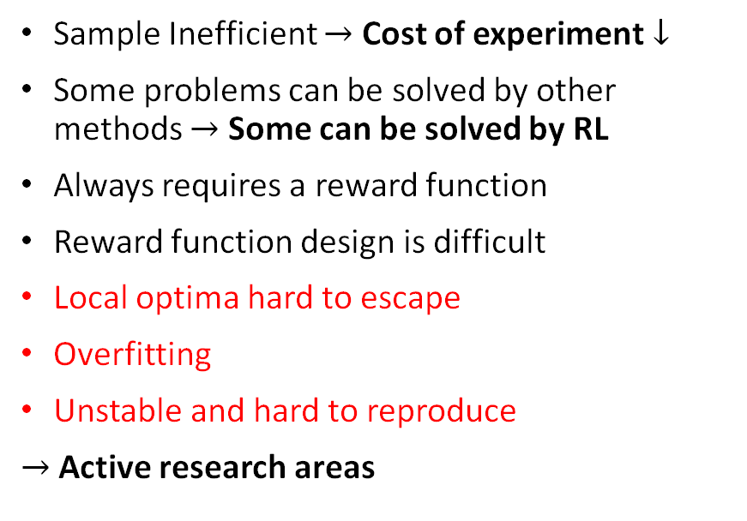
Why RL works now?
Sample Inefficient $→$ Cost of experiment $↓$
Some problems can be solved by other methods $→$ Some can be solved by RL
Always requires a reward function
Reward function design is difficult
Local optima hard to escape
Overfitting
Unstable and hard to reproduce
$→$ Active research areas

Slide 12

Why RL works now?
Sample Inefficient $→$ Cost of experiment $↓$
Some problems can be solved by other methods $→$ Some can be solved by RL
Always requires a reward function
Reward function design is difficult
Local optima hard to escape
Overfitting
Unstable and hard to reproduce
$→$ Active research areas
RL

Slide 13
In the context of RL…
Agent, environment, observations, state, reward, action, value, return, discount …
Evaluation, Iteration, Improvement, Value Iteration …
Monte Carlo, Off-policy
Temporal Difference, Q-learning, Sarsa
Function Approximation
Policy Gradient Methods

Slide 14
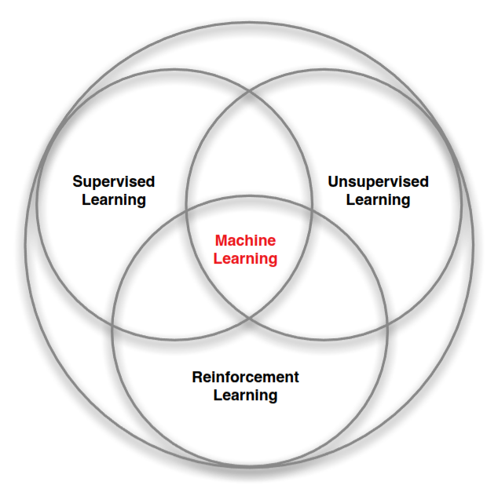
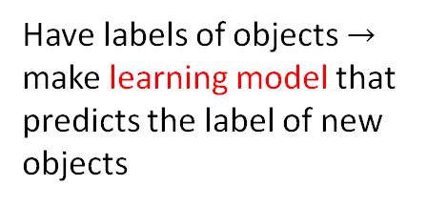
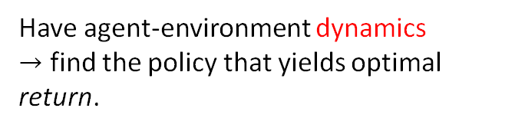
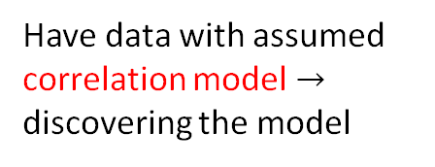
Have labels of objects $→$ make learning model that predicts the label of new objects
Have data with assumed correlation model $→$ discovering the model
Have agent-environment dynamics
$→$ find the policy that yields optimal return.

Slide 15
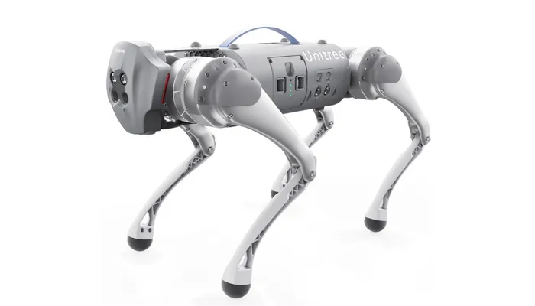
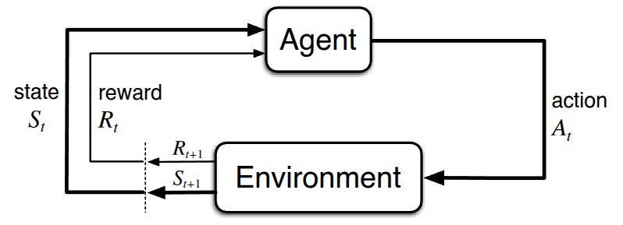
Agent and Environment
Agent: receives observations and rewards, generates action.
Environment: receives action, produces observation and reward.
The robot belongs to which category?
“All goals can be described by the maximization of expected cumulative reward”

Slide 16
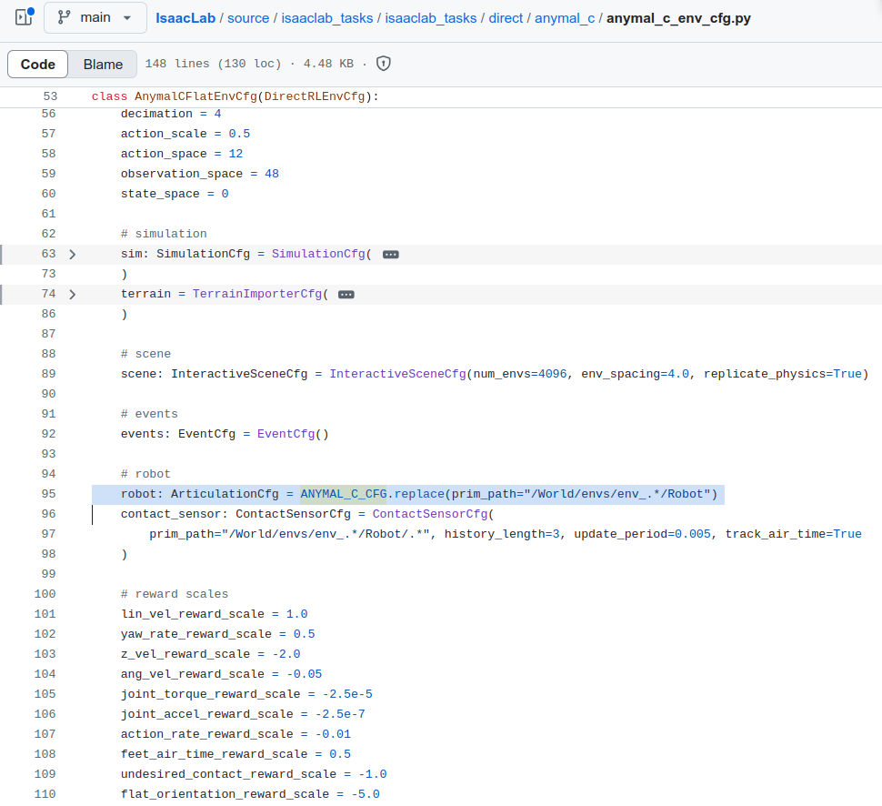

Slide 17
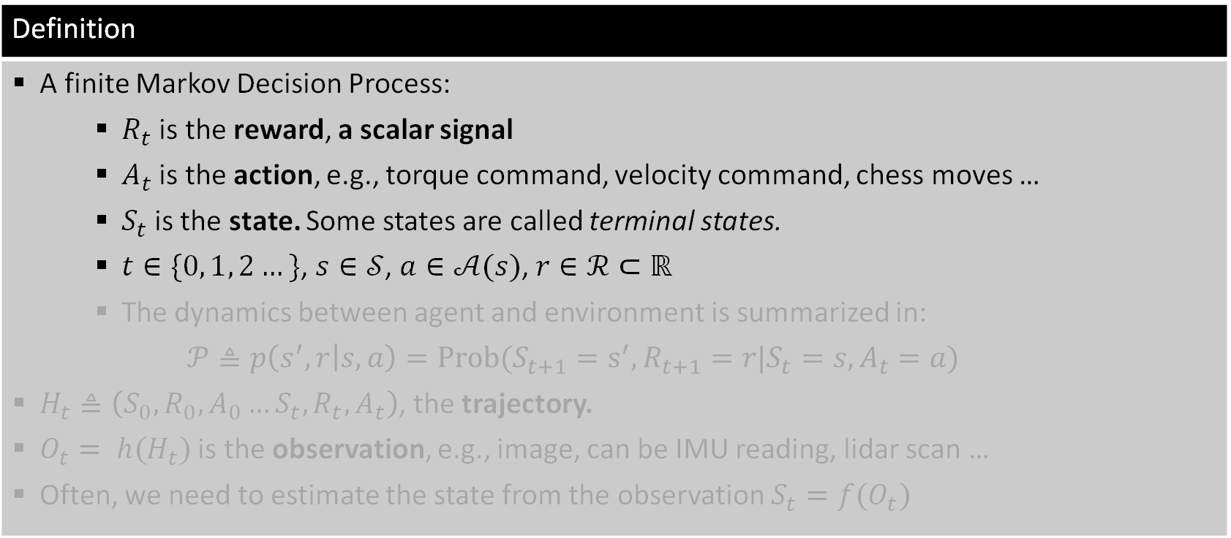
Concepts (1)
Definition
A finite Markov Decision Process: $R_{t}$ is the reward, a scalar signal $A_{t}$ is the action, e.g., torque command, velocity command, chess moves … $S_{t}$is the state. Some states are called terminal states. $t∈\{0, 1, 2…\}$, $s∈𝒮$, $a∈𝒜(s)$, $r∈ℛ⊂ℝ$ The dynamics between agent and environment is summarized in: $$𝒫≜p\left(s^{′},r | s,a\right)=Prob(S_{t+1}=s^{′},R_{t+1}=r|S_{t}=s,A_{t}=a)$$ $H_{t}≜\left(S_{0},R_{0},A_{0}…S_{t},R_{t},A_{t}\right)$, the trajectory. $O_{t}= h(H_{t})$ is the observation, e.g., image, can be IMU reading, lidar scan … Often, we need to estimate the state from the observation $S_{t}=f(O_{t})$

Slide 18
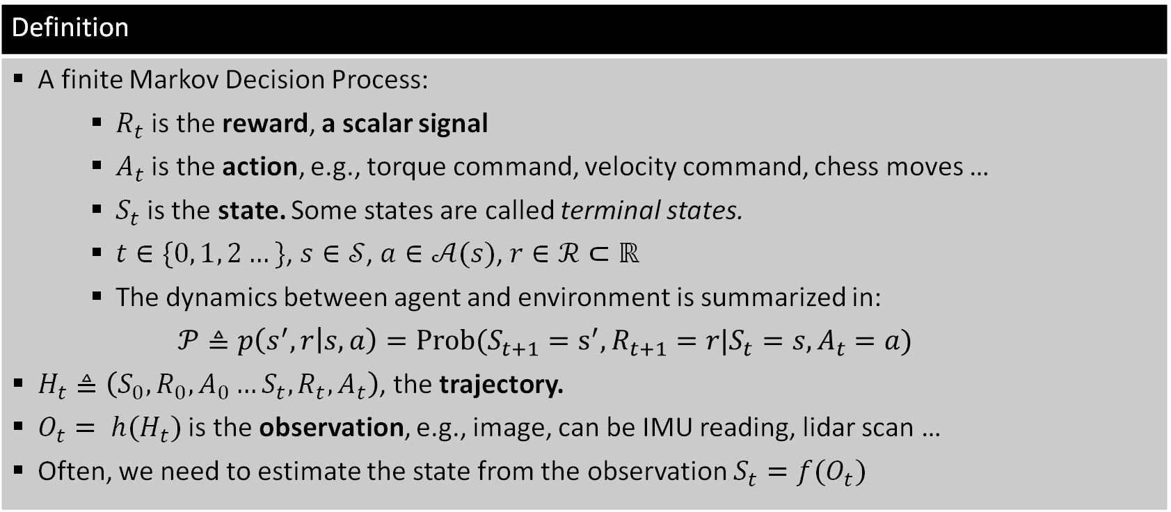
Concepts (1)
Definition
A finite Markov Decision Process: $R_{t}$ is the reward, a scalar signal $A_{t}$ is the action, e.g., torque command, velocity command, chess moves … $S_{t}$is the state. Some states are called terminal states. $t∈\{0, 1, 2…\}$, $s∈𝒮$, $a∈𝒜(s)$, $r∈ℛ⊂ℝ$ The dynamics between agent and environment is summarized in: $$𝒫≜p\left(s^{′},r | s,a\right)=Prob(S_{t+1}=s^{′},R_{t+1}=r|S_{t}=s,A_{t}=a)$$ $H_{t}≜\left(S_{0},R_{0},A_{0}…S_{t},R_{t},A_{t}\right)$, the trajectory. $O_{t}= h(H_{t})$ is the observation, e.g., image, can be IMU reading, lidar scan … Often, we need to estimate the state from the observation $S_{t}=f(O_{t})$

Slide 19
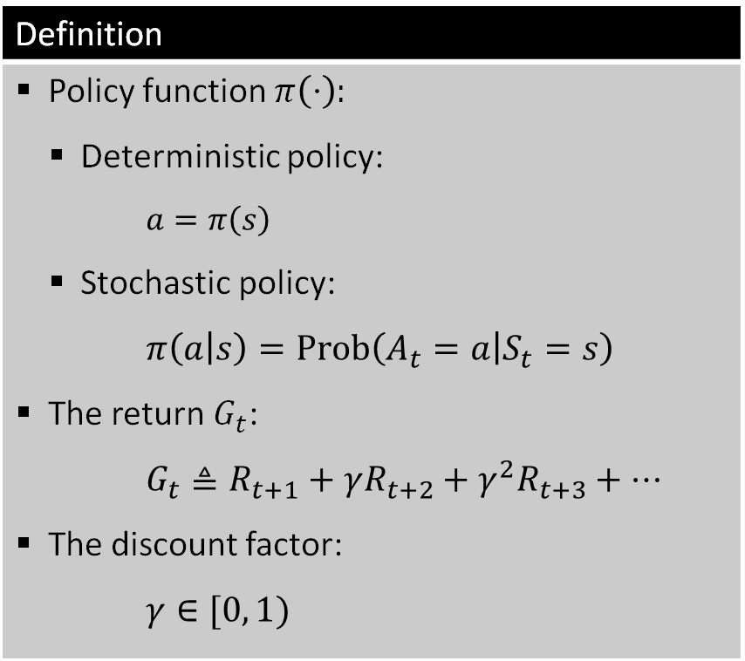
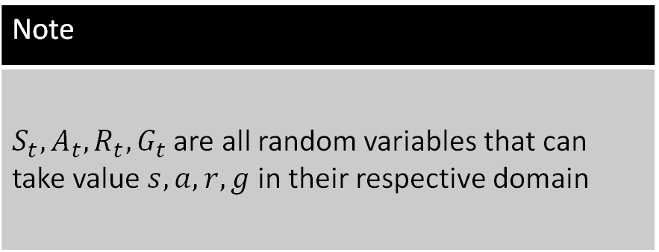
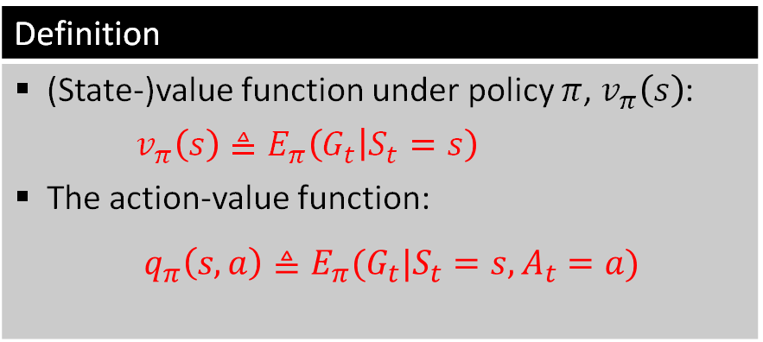
Concepts (2) ^{[1]}
Definition
Policy function $π\left(⋅\right):$ Deterministic policy: $$a=π\left(s\right)$$ Stochastic policy: $$π\left(a | s\right)=Prob\left(A_{t}=a | S_{t}=s\right)$$ The return $G_{t}$: $$G_{t}≜R_{t+1}+γR_{t+2}+γ^{2}R_{t+3}+…$$ The discount factor: $$γ∈[0, 1)$$
Definition
(State-)value function under policy $π$, $v_{π}\left(s\right)$: $v_{π}\left(s\right)≜E_{π}\left(G_{t} | S_{t}=s\right)$ The action-value function: $$q_{π}\left(s,a\right)≜E_{π}(G_{t}|S_{t}=s, A_{t}=a)$$
Note
$S_{t},A_{t},R_{t},G_{t}$ are all random variables that can take value $s,a, r,g$ in their respective domain

Slide 20

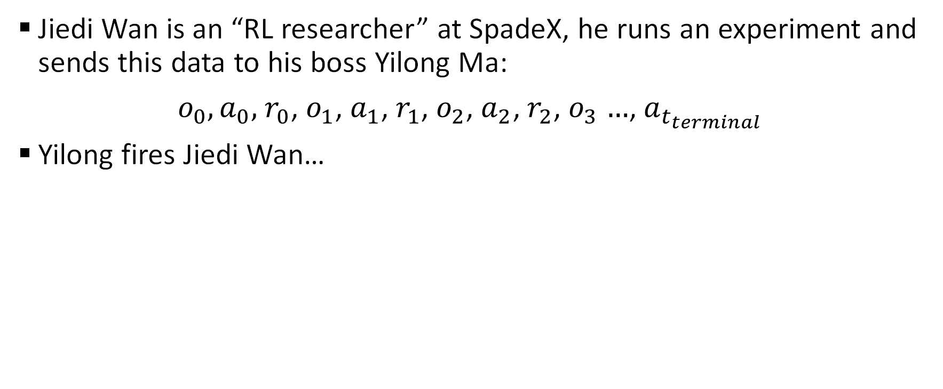
Somewhere in the multiverse…
Jiedi Wan is an “RL researcher” at SpadeX, he runs an experiment and sends this data to his boss Yilong Ma:
$o_{0},a_{0},$ $r_{0}$, $o_{1}$, $a_{1}$, $r_{1}$, $o_{2}$, $a_{2}$, $r_{2}$, $o_{3}$ $…$, $a_{t_{terminal}}$
Yilong fires Jiedi Wan…
https://tinyurl.com/tmnRL2025

Slide 21
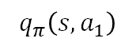
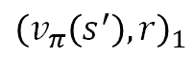
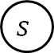
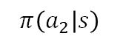
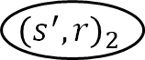
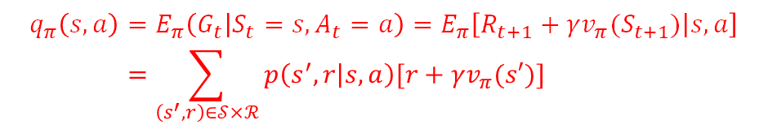
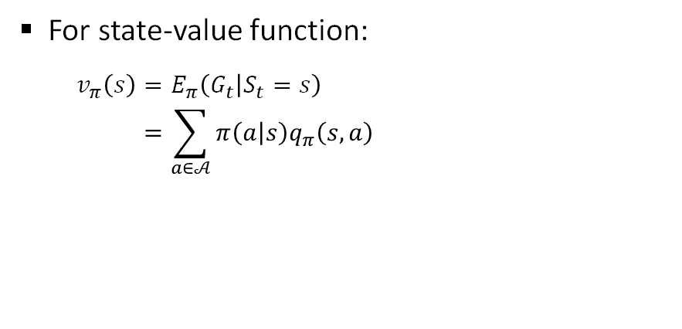
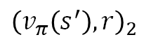
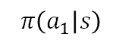
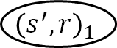






Bellman Equation
For state-value function:
$$v_{π}\left(s\right)=E_{π}\left(G_{t} | S_{t}=s\right) \\ =\sum_{a∈𝒜}{π\left(a | s\right)q_{π}\left(s,a\right)}$$
For action-value function:
$$q_{π}\left(s,a\right)=E_{π}\left(G_{t} | S_{t}=s, A_{t}=a\right)=E_{π}\left[R_{t+1}+γv_{π}(S_{t+1}) | s,a\right] \\ =\sum_{\left(s^{′},r\right)∈𝒮×ℛ}{p\left(s^{′},r | s,a\right)[r+γv_{π}(s′)]}$$
$$s$$
$$s,a$$
$$π\left(a_{1} | s\right)$$
$$π\left(a_{2} | s\right)$$
$$p\left({\left(s^{′},r\right)}_{1} | s,a\right)$$
$$p\left({\left(s^{′},r\right)}_{2} | s,a\right)$$
$$s,a_{1}$$
$$s,a_{2}$$
$${\left(s^{′},r\right)}_{1}$$
$${\left(s^{′},r\right)}_{2}$$
$$q_{π}\left(s,a_{1}\right)$$
$$q_{π}\left(s,a_{2}\right)$$
$${\left(v_{π}\left(s^{′}\right), r\right)}_{1}$$
$${\left(v_{π}\left(s^{′}\right), r\right)}_{2}$$

Slide 22


Bellman Equation
For state-value function:
$$v_{π}\left(s\right)=E_{π}\left(G_{t} | S_{t}=s\right) \\ =\sum_{a∈𝒜}{π\left(a | s\right)q_{π}\left(s,a\right)} \\ =\sum_{a∈𝒜}{π\left(a | s\right)\sum_{\left(s^{′},r\right)∈𝒮×ℛ}{p\left(s^{′},r | s,a\right)[r+γv_{π}(s′)]}}$$
For action-value function:
$$q_{π}\left(s,a\right)=E_{π}\left(G_{t} | S_{t}=s, A_{t}=a\right)=E_{π}\left[R_{t+1}+γv_{π}(S_{t+1}) | s,a\right] \\ =\sum_{\left(s^{′},r\right)∈𝒮×ℛ}{p\left(s^{′},r | s,a\right)[r+γv_{π}(s′)]} \\ =\sum_{\left(s^{′},r\right)∈𝒮×ℛ}{p\left(s^{′},r | s,a\right)\left[r+γ\sum_{a^{′}∈𝒜(s′)}{π\left(a′ | s′\right)q_{π}\left(s^{′},a′\right)}\right]}$$

Slide 23


Optimal Value Functions & BOE
Definition
$π>π^{′}⇒v_{π}\left(s\right)>v_{π^{′}}\left(s\right), ∀s$ The optimal state-value function $v_{∗}\left(s\right)$: $$v_{∗}\left(s\right)=\max_{π}{v_{π}\left(s\right)}$$ The optimal action-value function $q_{∗}\left(s,a\right)$: $$q_{∗}\left(s,a\right)=\max_{π}{q_{π}\left(s,a\right)}$$ For any optimal $π_{∗}$, all $s∈𝒮$, all $a∈𝒜\left(s\right)$: $$v_{∗}\left(s\right)=\max_{a∈𝒜(s)}{q_{∗}\left(s,a\right)} \\ q_{∗}\left(s,a\right)=\sum_{\left(s^{′},r\right)∈𝒮×ℛ}{p\left(s^{′},r | s,a\right)\left[r+γv_{∗}\left(s′\right)\right]}$$
Theorem
For any MDP: $∃π_{∗},π_{∗}≥π,∀π$ $v_{π_{∗}}\left(s\right)=v_{∗}\left(s\right), ∀π_{∗}$ $q_{π_{∗}}\left(s,a\right)=q_{π}\left(s,a\right), ∀π_{∗}$

Slide 24
In the context of RL…
Agent, environment, observations, state, reward, action, value, return, discount …
Evaluation, Iteration, Improvement, Value Iteration …
Monte Carlo, Off-policy
Temporal Difference, Q-learning, Sarsa
Function Approximation
Policy Gradient Methods

Slide 25




Solving the MDP
Policy iteration: from some $π$ $→$ evaluate $π$ $→$ improve $π$, repeat until $π{≈π}^{∗}$
Value iteration: a direct approach that achieves faster convergence.
evaluation
improvement
(given $π$ find $v_{π}$)
(given $v_{π}$find $π^{′}≥π$)

Slide 26


Solving the MDP
Policy Evaluation:
Given a policy $π\left(a|s\right)$ For $k=0…K−1$: $$∀s∈𝒮: V_{k+1}\left(s\right)←\sum_{a∈𝒜}{π\left(a | s\right)\sum_{\left(s^{′},r\right)∈𝒮×ℛ}{p\left(s^{′},r | s,a\right)\left[r+γV_{k}\left(s^{′}\right)\right]}},$$ $V_{k}\left(s\right)\underset{→}{K→∞}v_{π}(s)$
Policy Improvement:
Given a value function $v_{π}(s)$: $π_{∗}=greedy(v_{π}(s))$
Policy Iteration

Slide 27


Solving the MDP
Policy Evaluation:
Given a policy $π\left(a|s\right)$ For $k=0…K−1$: $$∀s∈𝒮: V_{k+1}\left(s\right)←\sum_{a∈𝒜}{π\left(a | s\right)\sum_{\left(s^{′},r\right)∈𝒮×ℛ}{p\left(s^{′},r | s,a\right)\left[r+γV_{k}\left(s^{′}\right)\right]}},$$ $V_{k}\left(s\right)\underset{→}{K→∞}v_{π}(s)$
Policy Improvement:
Given a value function $v_{π}(s)$: $π_{∗}=greedy(v_{π}(s))$
Policy Iteration

Slide 28


Policy Evaluation – Grid World Example

Slide 29

Policy Evaluation – Grid World Example

Slide 30

Policy Evaluation – Grid World Example

Slide 31

Policy Evaluation – Grid World Example

Slide 32
Policy Iteration

Slide 33



Value Iteration
Value Iteration:
Find the optimal policy $π_{∗}$: Given $V_{0}\left(s\right):$ Repeat: For each $s∈𝒮$ $V_{k+1}\left(s\right)←\max_{a∈𝒜(s)}{\sum_{\left(s^{′},r\right)∈𝒮×ℛ}{p\left(s^{′},r | s,a\right)\left[r+γV_{k}\left(s^{′}\right)\right]}}$
Or by invoking the state-action value
Value Iteration:
Find the optimal policy $π_{∗}$: Given $V_{0}\left(s\right):$ Repeat: For each $s∈𝒮$: For each $a∈𝒜\left(s\right)$: $Q\left(s,a\right)←\sum_{\left(s^{′},r\right)∈𝒮×ℛ}{p\left(s^{′},r | s,a\right)\left[r+γV_{k}\left(s^{′}\right)\right]}$ $V_{k+1}\left(s\right)←\max_{a∈𝒜(s)}{Q\left(s,a\right)}$

Slide 34





Tutorial: Tic-Tac-Toe by Value Iteration
Notes:
‘x’ goes first w.l.o.g. For 3x3 game, neither player can lose if they play optimally: $→$ Do not train the AI, play dumb and see that it takes dumb move. $→$ Do train the AI, play dumb, and lose to it. $→$ Do Train the AI, play smart, and never win over it.
Notes:
$𝒮={\left\{1,−1,0\right\}}^{9}$ $R_{t}=\left\{\begin{aligned} 1, if s_{t} win \\ &−1, if s_{t} loses \\ 0, otherwise\end{aligned}\right.$ $p\left(s^{′},r | s,a\right)$ =$\left\{\begin{aligned}\frac{1}{\left|legal(s^{′})\right|}, if \left(s^{′},r\right) is possible \\ 0, otherwise\end{aligned}\right.$ Transition: …
o | o
 | x | x
 | o
o | o | x
 | x | x
 | o
o | o | x
o | x | x
 | o
o | o | x
 | x | x
o | o
o | o | x
 | x | x
 | o | o
$$s$$
$$s,a$$
$$\{s′\}$$
https://tinyurl.com/tmnDRL2025TTT

Slide 35
In the context of RL…
Agent, environment, observations, state, reward, action, value, return, discount …
Evaluation, Iteration, Improvement, Value Iteration …
Monte Carlo, Off-policy
Temporal Difference, Q-learning, Sarsa
Function Approximation
Policy Gradient Methods

Slide 36

Monte Carlo Methods
In real world, most of the time we have imperfect knowledge $→$ estimate.
Monte Carlo methods are model-free

Slide 37

Monte Carlo Evaluation
Goal: Given the data acquired under $π$, estimate $q_{π}$.
Approach: Express $q_{π}$-estimation problem as $v_{π}$-estimation problem,
Define a new problem where:
$${\overline{S}}_{t}=(S_{t},A_{t})$$
$→$ Estimating $v(\overline{s})$ is equivalent to estimating $q_{π}\left(s,a\right)$.
Data = $\left\{H_{m}=\left({\overline{s}}_{0},{\overline{s}}_{1},…{\overline{s}}_{T_{m}}\right), m=1…M\right\}$.
$→$ Markov Reward Process.
_______________________________________________________________________________________________

Slide 38

Monte Carlo Evaluation
Goal: Given the data acquired under $π$, estimate $q_{π}$.
Approach: Express $q_{π}$-estimation problem as $v_{π}$-estimation problem,
Define a new problem where:
$${\overline{S}}_{t}=(S_{t},A_{t})$$
$→$ Estimating $v(\overline{s})$ is equivalent to estimating $q_{π}\left(s,a\right)$.
Data = $\left\{H_{m}=\left({\overline{s}}_{0},{\overline{s}}_{1},…{\overline{s}}_{T_{m}}\right), m=1…M\right\}$.
$→$ Markov Reward Process.
_______________________________________________________________________________________
Idea: Use averages to approximate $v_{π}\left(s\right)≈V(s)$:
Batch update:
$$v_{π}\left(s\right)=E_{π}\left(G_{t} | S_{t}=s\right)≈\frac{1}{C\left(s\right)}\sum_{m=1}^{M}{\sum_{τ=0}^{T_{m}−1}{𝕀\left[s_{τ}^{m}=s\right]}g_{τ}^{m}}≜V(s)$$

Slide 39


Monte Carlo Evaluation
Goal: Given the data acquired under $π$, estimate $q_{π}$.
Approach: Express $q_{π}$-estimation problem as $v_{π}$-estimation problem,
Define a new problem where:
$${\overline{S}}_{t}=(S_{t},A_{t})$$
$→$ Estimating $v(\overline{s})$ is equivalent to estimating $q_{π}\left(s,a\right)$.
Data = $\left\{H_{m}=\left({\overline{s}}_{0},{\overline{s}}_{1},…{\overline{s}}_{T_{m}}\right), m=1…M\right\}$.
$→$ Markov Reward Process.
_______________________________________________________________________________________________
Idea: Use averages to approximate $v_{π}\left(s\right)≈V(s)$:
Batch update:
$$v_{π}\left(s\right)=E_{π}\left(G_{t} | S_{t}=s\right)≈\frac{1}{C\left(s\right)}\sum_{m=1}^{M}{\sum_{τ=0}^{T_{m}−1}{𝕀\left[s_{τ}^{m}=s\right]}g_{τ}^{m}}≜V(s)$$
Iterative update after the $m$-th sample:
$$V\left(s_{t}^{m}\right)←V\left(s_{t}^{m}\right)+\frac{1}{C\left(s_{t}^{m}\right)}\left(g_{t}^{m}−V\left(s_{t}^{m}\right)\right)$$
Or simply use a constant step size:
$$V\left(s_{t}^{m}\right)←V\left(s_{t}^{m}\right)+α\left(g_{t}^{m}−V\left(s_{t}^{m}\right)\right)$$

Slide 40

MC Control

Slide 41


Monte Carlo Evaluation

Slide 42


Caveats of MC
Trajectories have to terminate
Exploration-Exploitation dichotomy:
To discover optimal policies, we must explore all state-action pairs.
To get high returns we must exploit known high state-action pairs.

Slide 43

Caveats of MC
Trajectories have to terminate
Exploration-Exploitation dichotomy:
To discover optimal policies, we must explore all state-action pairs.
To get high returns we must exploit known high state-action pairs.

Slide 44


Off-policy method
Goal:
Estimate $q_{π}\left(s,a\right)=E_{π}\left[G_{t} | S_{t}=s, A_{t}=a\right]$
Issue:
Data exists but collected under $b$
Remedy:
$$q_{π}\left(s,a\right)=E_{b}\left[\frac{p_{π}(G_{t})}{p_{b}(G_{t})}G_{t}|S_{t}=s,A_{t}=a\right] \\ ρ=\prod_{τ=t+1}^{T−1}{\frac{π\left(A_{τ} | S_{τ}\right)}{b\left(A_{τ} | S_{τ}\right)}}$$
$π\left(a,s\right)>0⇒b\left(a,s\right)>0$

Slide 45


Off-policy MC

Slide 46
In the context of RL…
Agent, environment, observations, state, reward, action, value, return, discount …
Evaluation, Iteration, Improvement, Value Iteration …
Monte Carlo, Off-policy
Temporal Difference, Q-learning, Sarsa
Function Approximation
Policy Gradient Methods

Slide 47

Temporal Difference Learning
a priori:
$$q_{π}\left(s,a\right)=E_{π}\left[G_{t} | \left(S_{t},A_{t}\right)=\left(s,a\right)\right]=E_{π}\left[R_{t+1}+γq_{π}\left(S_{t+1},A_{t+1}\right) | \left(S_{t},A_{t}\right)=\left(s,a\right)\right]$$
Just read through the maths: $Q\left(s_{t},a_{t}\right)≈g_{t}≈r_{t}+γQ(s_{t+1},a_{t+1})$
MC approach:
$$g_{t}^{m}=r_{t+1}^{m}+γr_{t+2}^{m}…γ^{T_{m}−1}r_{T_{m}}^{m}$$
$$Q\left(s_{t}^{m},a_{t}^{m}\right)←Q\left(s_{t}^{m},a_{t}^{m}\right)+α\left(g_{t}^{m}−Q\left(s_{t}^{m},a_{t}^{m}\right)\right)$$
target

Slide 48

Temporal Difference Learning
a priori:
$$q_{π}\left(s,a\right)=E_{π}\left[G_{t} | \left(S_{t},A_{t}\right)=\left(s,a\right)\right]=E_{π}\left[R_{t+1}+γq_{π}\left(S_{t+1},A_{t+1}\right) | \left(S_{t},A_{t}\right)=\left(s,a\right)\right]$$
Just read through the maths: $Q\left(s_{t},a_{t}\right)≈g_{t}≈r_{t}+γQ(s_{t+1},a_{t+1})$
MC approach:
$$g_{t}^{m}=r_{t+1}^{m}+γr_{t+2}^{m}…γ^{T_{m}−1}r_{T_{m}}^{m}$$
$$Q\left(s_{t}^{m},a_{t}^{m}\right)←Q\left(s_{t}^{m},a_{t}^{m}\right)+α\left(g_{t}^{m}−Q\left(s_{t}^{m},a_{t}^{m}\right)\right)$$
1-step TD approach:
$${\hat{g}}_{t}^{m}=r_{t+1}^{m}+γQ(s_{t+1},a_{t+1})$$
$$Q\left(s_{t}^{m},a_{t}^{m}\right)←Q\left(s_{t}^{m},a_{t}^{m}\right)+α\left({\hat{g}}_{t}^{m}−Q\left(s_{t}^{m},a_{t}^{m}\right)\right)$$
target
bootstrap
target

Slide 49



SARSA
On Policy TD Control: n-step SARSA
Changes:
Approximating the rewards beyond the n-th step with the current value of $Q(s,a)$ (bootstrapping):
Updates happen during the episode, Interweaving between ($S,A,R$) tuples, with an n step delay.
The policy is updated in similar manner with MC

Slide 50


TD $∋$ MC

Slide 51

TD $∋$ MC

Slide 52

Q-learning

Slide 53
In the context of RL…
Agent, environment, observations, state, reward, action, value, return, discount …
Evaluation, Iteration, Improvement, Value Iteration …
Monte Carlo, Off-policy
Temporal Difference, Q-learning, Sarsa
Function Approximation
Policy Gradient Methods

Slide 54

Function Approximation
When $𝒮$ is continuous $→$ never enough data.
Example:
Assume $v_{π}\left(s\right)=\hat{v}(s,w)$, $\hat{v}\left(s+δ,w\right)=\hat{v}\left(s+δ,w\right)+{\left(\frac{∂\hat{v}}{∂s}\right)}^{⊤}δ$.
Goal:
$$\min_{w}\sum_{s∈\{s_{i}\}}{{\left\|v_{π}\left(s_{i}\right)−\hat{v}\left(s_{i},w\right)\right\|}^{2}}$$
Update rule:
$$w←w+α\left[g_{i}−\hat{v}\left(s_{i},w\right)\right]∇_{w}\hat{v}\left(s_{i},w\right)$$
$$∇_{w}\hat{v}\left(s_{i},w\right)=\frac{∂\hat{v}}{∂w}$$
DRL $→$ $w$ is param of DNN.

Slide 55

Function Approximation
Example:
Assume $q_{π}\left(s\right)=\hat{q}(s,a,w)$
Goal:
$$\min_{w}\sum_{s∈\{s_{i}\}}{{\left\|q_{π}\left(s_{i},a_{i}\right)−\hat{q}\left(s_{i},a_{i},w\right)\right\|}^{2}}$$
Update rule:
$$w←w+α\left[G_{i}−\hat{q}\left(s_{i},a_{i},w\right)\right]∇_{w}\hat{q}\left(s_{i},a_{i},w\right)$$
$$∇_{w}\hat{q}\left(s_{i},a_{i},w\right)=\frac{∂\hat{q}}{∂w}$$

Slide 56
Function Approximation
What about the policy function?

Slide 57
In the context of RL…
Agent, environment, observations, state, reward, action, value, return, discount …
Evaluation, Iteration, Improvement, Value Iteration …
Monte Carlo, Off-policy
Temporal Difference, Q-learning, Sarsa
Function Approximation
Policy Gradient Methods

Slide 58



Policy Gradient Methods
$∇_{θ}lnπ(a_{t}|s_{t},θ)$ gives the “direction” that increasing $θ$ will increase $π(a_{t}|s_{t},θ)$.
Notes:
Given an action $a_{t}$, we find the “direction” to change $θ$ that increases the probability of action a , i.e. $∇lnπ(a_{t})$. Based on the return $g_{t}$ of action $a_{t}$, we proportionally apply the update of $θ$

Slide 59

Policy Gradient Methods
$∇_{θ}lnπ(a_{t}|s_{t},θ)$ gives the “direction” that increasing $θ$ will increase $π(a_{t}|s_{t},θ)$.
The increase of $θ$ is $\sim g_{t}∇_{θ}lnπ(a_{t}|s_{t},θ)$
Notes:
Given an action $a_{t}$, we find the “direction” to change $θ$ that increases the probability of action a , i.e. $∇lnπ(a_{t})$. Based on the return $g_{t}$ of action $a_{t}$, we proportionally apply the update of $θ$

Slide 60

Policy Gradient Methods
$∇_{θ}lnπ(a_{t}|s_{t},θ)$ gives the “direction” that increasing $θ$ will increase $π(a_{t}|s_{t},θ)$.
The increase of $θ$ is $\sim g_{t}∇_{θ}lnπ(a_{t}|s_{t},θ)$
$→$ the higher the return $g_{t}$ an action $a_{t}$ yields, the higher the probability of an action is increased.
Notes:
Given an action $a_{t}$, we find the “direction” to change $θ$ that increases the probability of action a , i.e. $∇lnπ(a_{t})$. Based on the return $g_{t}$ of action $a_{t}$, we proportionally apply the update of $θ$

Slide 61


Policy Gradient Methods
Actor-Critic Methods combine elements of policy-based methods and value-based methods.
It introduces an advantage function
$$A(s_{i},a_{i})=Q\left(s,a\right)−V(s)$$
$→$ provides a measure of how “good” and action is compared with the average action.
“Actor” gradient:
$$∇_{θ}J\left(θ\right)≈\frac{1}{N}\sum_{i}{∇_{θ}ln\left(π\left(a_{i} | s_{i},θ\right)\right)A\left(s_{i},a_{i}\right)}$$
“Critic” gradient:
$$∇_{w}J\left(w\right)≈\frac{1}{N}\sum_{i}{∇_{w}A{\left(s_{i},a_{i}\right)}^{2}}$$

Slide 62

Tutorial: CartPole by REINFORCE method
https://www.gymlibrary.dev/environments/classic_control/cart_pole/
https://tinyurl.com/tmn2025DRLCartpole
End when score = 050 for 100 steps
End when score = 100 for 100 steps
End when score = 200 for 100 steps
End when score = 400 for 100 steps

Slide 63



Summary
Model-based RL
Model-free RL
Gradient-free
Off-Policy
On-Policy
Value Evaluation, Policy Iteration, Policy Improvement, Value Iteration…
MC
TD, Q-learning, Sarsa
Function Approximation (Deep RL)
Policy Gradient Methods
(1)
$⋮$
($∞$) $≡$
Gradient-based
$$θ←θ+α∇lnπ$$

Slide 64


References
Reinforcement Learning: An Introduction, Sutton
David Silver RL Lectures
Zhao Shiyu RL Lectures
OpenAI Introduction to RL

Slide 65



